Slide 1
SMHS Bloodborne Pathogen Exposure Immediate Steps
Judy Solberg, Ph.D., M.P.A.

Slide 2
Immediately
Clean the injured site
Needle-stick injuries and cuts: Wash affected area with soap and water
Splashes to the nose, mouth, or skin: Rinse with water for 10 minutes
Splashes to the eyes: Proceed to the nearest eyewash station and flush for a minimum of 15 minutes, rolling the eyes left to right and up and down. Contact lenses may be gently taken out during flushing.
If no eyewash station is available, irrigate eyes with clean water, sterile saline or sterile irrigants in the same manner as above.
Report the incident to your immediate supervisor

Slide 3
Within One Hour
Go to a licensed health care provider for an immediate medical evaluation, counseling, testing, and devise a plan for follow-up care. Considerations for post-exposure prophylaxis: the type of exposure, type, and amount of fluid/issue, infectious state of the source, and susceptibility of the exposed student. Prophylaxis should be started as soon as possible after HIV exposure.

Slide 4
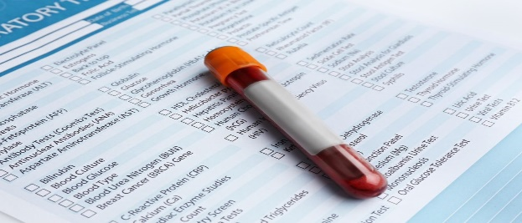
Within Two Hours
The student’s immediate supervisor, where the incident occurred, requests both the student’s and the source patient’s lab test workup (if blood or body fluid exposure). A minimum of Hepatitis B surface antigen (HBsAg), Hepatitis C antibody (anti-HCV), and HIV-1/2 testing is to be completed on both the student and the source patient.

Slide 5
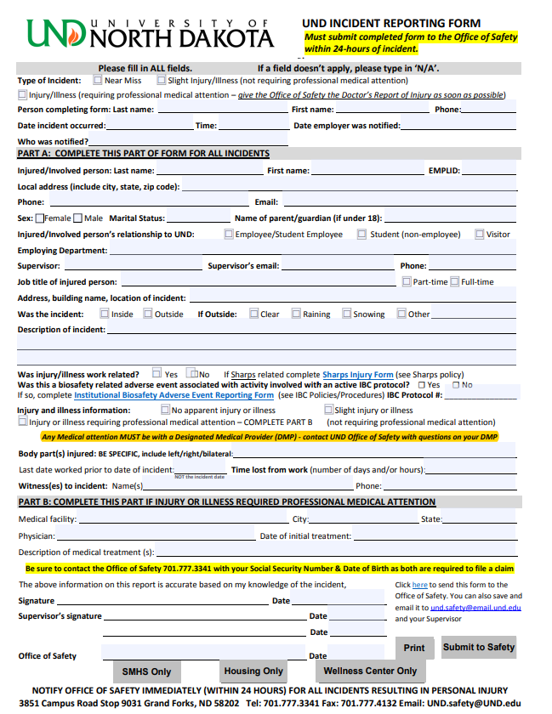
Within Twenty-Four Hours
Student notifies SMHS contact of incident.
Complete UND’s “Incident Reporting Form” and submit it to the Office of Safety and the Dean’s Office. Student’s academic department keeps a copy of the record, pursuant to
UND’s Records Retention
Schedule.
NOTE: If the incident occurred on UND’s campus, you must also
Complete the Sharp’s Injury Log Form.

Slide 6
Within Twenty-Four Hours Cont.…
Immediate supervisor at the location of the incident ensures that test results of source patient are relayed to student’s health care provider. If the student chooses to withhold consent for testing, their blood sample will be housed at the facility where the incident occurred for 90 days.

Slide 7
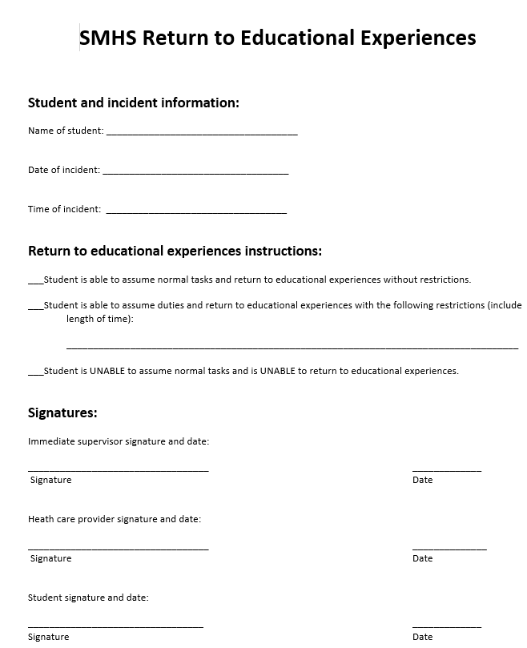
Within Twenty-Four Hours Cont.…
Student, immediate supervisor, and health care provider complete the “SMHS Return to Educational Experiences” form and return it to respective SMHS contact.
When can students return to their educational experience?

Slide 8
Refusal of Care
If the student refuses care, the student must complete the “Refusal of Care Form” and send on to the UND Office of Safety. The Department must also keep a copy pursuit to UND’s Records Retention Schedule.

Slide 9
Within Forty-Eight Hours
An investigation by the appropriate person within the program must be done.
Part One and Part Two of the “UND Incident Investigation Form” (it’s actually two SEPARATE forms) must be completed and forwarded on to UND’s Office of Safety.

Slide 10
Important Take Aways
Bloodborne pathogen exposures ARE an emergency
Consult UND SMHS’s Bloodborne Pathogen Exposure Immediate Steps Sheet any time there is an exposure (located on the SMHS’s website, in the green bar at the bottom, under “important links”
All students, including visiting students, are responsible for all financial costs associated with an exposure

Slide 11
Closing

